Slide 1

UNIT
DAY 26
02
ONE MORE LAP
BUILT TO ORDER
AGENDA
REMINDERS
Phones into The Holding Cell
Open/Closed Laptop
Lab 2-8 open/accessible
Start Your Engines
Warm Up
Live Code: Lap Times
Fill the Gaps
The Fundraiser Tracker
Exit Ticket
RECOMMENDED LISTENING:
MUTE CITY – F-ZERO
Notes:
Day 26: consolidation. One new idea today (a second variable that changes inside the loop); everything else is practice. No paper: fingers for the warm up and hinge questions.

Slide 2
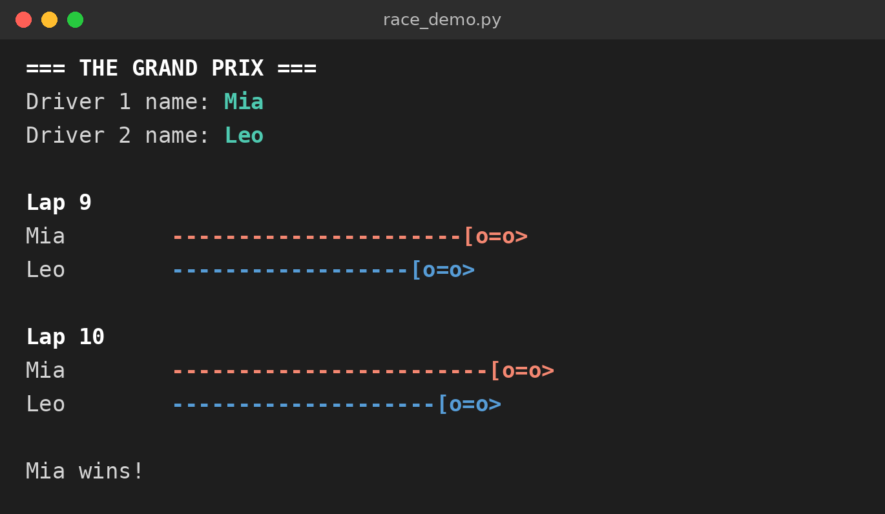
START YOUR ENGINES
The whole race is one loop: ten laps, ten passes.
→ By the end of today you should be able to understand every line of this program
Notes:
Run race_demo.py live (the screenshot is a backup). Ask two visitors to type the driver names, take a finger vote on the winner, then run it. If time allows, run it twice: the winner changes because each lap adds a random 1 to 3. Do not explain the code yet.

Slide 3
PREDICTION GRAND PRIX
All lesson, your team races on the board.
Teams of 3 or 4, with a visitor in every team.
Each time I ask “what will it print?”, every team answers with fingers.
Right answer: your kart moves one lap. Hinge questions: two laps.
Visitors are navigators: read the code and tell your driver what to try. Drivers type.
→ Winners are announced at the exit ticket.
Notes:
Draw a simple oval track on the board with one marker per team. Seat each visitor next to a confident student; they stay together as navigator and driver for the lab. Keep scoring quick: count fingers, move the karts, carry on.

Slide 4

THE WARM UP QUESTION
From memory. Show your answer with fingers when asked.
# a) Last floor printed?
for floor in range(3, 8):
print("Floor", floor)
# c) How many lines?
lives = 3
while lives > 0:
print("Playing with", lives, "lives")
# b) Version A: how many lines?
coins = 0
for level in range(1, 4):
coins = coins + 50
print(coins)
# b) Version B: how many lines?
coins = 0
for level in range(1, 4):
coins = coins + 50
print(coins)
Notes:
Take each question in turn: fingers up on three. a) Floor 7. b) A prints 3 lines (50, 100, 150), B prints 1 (150). c) it never stops. Make a note of anyone who misses a) or b): sit with them during the planner.

Slide 5
THE WARM UP ANSWER
a) Floor 7. range(3, 8) stops before 8.
b) A prints three lines (50, 100, 150). B prints one line (150).
  Indented under the loop: runs every pass. Not indented: runs once, after the loop.
c) It never stops. lives never changes, so lives > 0 is always True.
→ Lab Warm Up: type your answers to a), b) and c), then run each one to check.
Notes:
Do not reteach yesterday. Note who missed a) and b); those two ideas break everything that follows.

Slide 6
LIVE CODE: LAP TIMES
Hands off keyboards. Predict before every run.
New today: a second variable (lap_time) that changes on every pass.
We build this one step at a time.
laps = 4
lap_time = 60
total_time = 0
for lap in range(1, laps + 1):
print("Lap", lap, "-", lap_time, "seconds")
total_time = total_time + lap_time
lap_time = lap_time - 5
print("Race time:", total_time, "seconds")
Notes:
This slide is the destination, not the lesson: type it from day26_teacher.py in five steps (loop only; add lap_time; add total_time; add the if inside; add the track-record if after the loop). Every correct prediction scores a lap in the Prediction Grand Prix. Ask for a prediction before each run. Then make the two deliberate mistakes in the file and let the class diagnose them.

Slide 7
TRACE IT TOGETHER
One column per variable, one row per pass.
The values are what they are at the end of each pass.
lap_time is printed first, then it drops. That is why lap 1 shows 60, not 55.
→ Lab question 1: fill in the trace table.
Step | lap | lap_time | total_time | Printed
Before
Pass 1
Pass 2
Pass 3
Pass 4
After
laps = 4
lap_time = 60
total_time = 0
for lap in range(1, laps + 1):
print("Lap", lap, "-", lap_time, "seconds")
total_time = total_time + lap_time
lap_time = lap_time - 5
print("Race time:", total_time, "seconds")
Notes:
Fill this in with the class before revealing it, row by row. This is the same table students fill in for Lab question 1, and the skill they need for the exit ticket.

Slide 8
TRACE IT TOGETHER
One column per variable, one row per pass.
The values are what they are at the end of each pass.
lap_time is printed first, then it drops. That is why lap 1 shows 60, not 55.
→ Lab question 1: fill in the trace table.
Step | lap | lap_time | total_time | Printed
Before | – | 60 | 0
Pass 1 | 1 | 55 | 60 | Lap 1 - 60
Pass 2 | 2 | 50 | 115 | Lap 2 - 55
Pass 3 | 3 | 45 | 165 | Lap 3 - 50
Pass 4 | 4 | 40 | 210 | Lap 4 - 45
After | 4 | 40 | 210 | Race time: 210
Notes:
Fill this in with the class before revealing it, row by row. This is the same table students fill in for Lab question 1, and the skill they need for the exit ticket.

Slide 9
QUESTION 1
Someone moved total_time = 0 inside the loop. What does the last line print?
Fingers: 1) Race time: 210 2) Race time: 45 3) Race time: 0 4) an error
lap_time = 60
for lap in range(1, 5):
total_time = 0
total_time = total_time + lap_time
lap_time = lap_time - 5
print("Race time:", total_time)
Notes:
Answer: 2) Race time: 45. total_time is reset to 0 on every pass, so it only ever holds the last lap. Hinge questions score double in the Grand Prix. If more than a few pick 1, run it and trace the last pass before moving on.

Slide 10
FILL THE GAPS
Same pattern, new context: tickets sold for the school play.
Four gaps. The lab shows exactly what it should print. → Lab question 2
days = 5
tickets = 40
total = ____
for day in range(1, ____):
if tickets >= 60:
print("Day", day, "-", tickets, "tickets - selling fast!")
else:
print("Day", day, "-", tickets, "tickets")
total = ____
tickets = ____
print("Total sold:", total, "tickets")
Notes:
About 8 minutes. Circulate. The most common wrong gap is range(1, 5), which prints only four days; point students back to warm up a).

Slide 11
QUESTION 2
The update moved above the print. What is the first line printed?
Fingers: 1) Day 1 - 40 2) Day 1 - 50 3) Day 0 - 40 4) Day 2 - 50
tickets = 40
for day in range(1, 6):
tickets = tickets + 10
print("Day", day, "-", tickets)
Notes:
Answer: 2) Day 1 - 50. The update runs before the print, so day 1 never shows 40. This ordering decision is the one the Fundraiser Tracker depends on: reteach with the trace table if needed.

Slide 12
THE FUNDRAISER TRACKER
A club fundraiser, week by week. New file; typed-in values until Checkpoint 5. Show me each checkpoint. Think of them like success criteria.
1 Print Week 1 to Week 4 (weeks = 4).
2 Print each week’s amount, then grow it: 50, 75, 100, 125.
3 Running total: 0 before the loop, printed once after it (350).
4 “ - record week!” at 100 or more; after the loop, goal reached or how far short.
5 Swap the typed-in values for input() and int().
→ Lab question 3
Notes:
About 27 minutes. Stamp each checkpoint by looking at the screen. Sit with the students who missed warm up a) or b). Anyone stuck at Checkpoint 2 should compare their code with the lap-time program; the goal check at Checkpoint 4 is the same move as live-code step 5 (the track record).

Slide 13
FINISHED EARLY?
Keep going until it passes 1000.
You save 1 dollar on day 1 and double it every day.
Use a while loop to find how many days it takes to have more than 1000.
Print the number of days and the final amount.
Why while here? You do not know how many days it will take until you get there.
→ Lab: Extension, in Section 3
Notes:
Answer: 10 days, 1024. This is the one while task today, and it is a natural fit for while, unlike yesterday’s countdown.

Slide 14
EXIT TICKET
→ Lab question 4: trace a three-pass loop.
→ Lab question 5: for or while? Sort four jobs.
Save your lab as Surname_Lab2-8 and upload it to ManageBac.
→ Last lap: look back at the Grand Prix. Which lines are the running totals?
Notes:
Answers: Q4 score 2, 6, 12, prints 12. Q5 for, while, for, while. Read these before Day 27: anyone who cannot trace Q4 needs another pass at tracing before Mini B. For the last minute, reopen race_demo.py: position1 and position2 are running totals, and every lap is one pass of the for loop. Announce the Grand Prix winners.

Slide 15

VOCAB TO REMEMBER
Iteration - one pass through a loop
range(a, b) - counts from a up to, but not including, b
Running total - starts at 0 before the loop, adds on every pass
Update - changing a variable inside the loop
Trace table - one column per variable, one row per pass
Infinite loop - a loop whose condition never becomes False
Notes:
Quick-fire if time allows.

Slide 16
FURTHER READING
Python docs: for statements
W3Schools: Python For Loops
W3Schools: Python While Loops
Notes:
Share the links on ManageBac.

